Slide 1
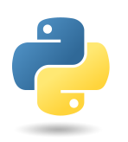

Introduction to python
Spark Makerspace

Slide 2
Overview of the Class
Brief Introduction to Python and the Spyder IDE
Interactive worksheet interspersed with presentations
Topics
  Variables
  Arithmetic
  Input/output
  Strings
Small Projects
A few tips
  Save your work frequently
  Learn the vocabulary, “use your words”
  Python is case-sensitive and picky about indenting
  Conditionals
  Lists
  Loops
  Functions

Slide 3
Example Applications of
Python Programming
See examples…

Slide 4



Course Mini-Project
Use concepts you have learned to write a program such as:
  Choose your own adventure
  Quizzer
  Virtual pet
  Your own idea
See demos

Slide 5
Instructor bio
Ian Frommer is a professor in the Department of Mathematics at the U.S. Coast Guard Academy (USCGA) where he teaches a wide range of courses in computing, operations research, and mathematics, and has developed several courses. Working as a full-time educator for the past 20 years, he has taught Python to new and experienced coders (including elementary school students). Dr. Frommer is a Certified Analytics Professional (CAP-X) and works in industry as an operations research / analytics consultant. He received an A.B. degree with high honors in Astronomy and Physics from Harvard College, and a Ph.D. in Applied Mathematics and Scientific Computation from the University of Maryland. In between degrees, he worked as a computer programmer in the New Technologies Department of Sony Music in New York City.

Slide 6
Computer Programming
Computer Programs:
  tell a computer the sequence of steps needed to complete a specific task
  consist of extremely primitive instructions, such as:
    Check if a value is larger than 2 and if so, carry out certain instructions
    Add two numbers
    Place a square at a given screen position
Programming:
  The act of designing, implementing and testing computer programs.
Programmer:
  YOU by the end of the class!

Slide 7
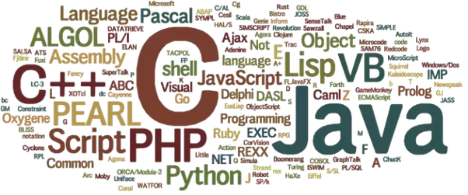
Programming Languages
Programs are written in a language
Languages are the intermediary between the human readable instructions and the 0s and 1s the computer works with
There are numerous languages:
Src: https://www.quora.com/Which-are-the-computer-languages-that-an-MCA-student-must-study
Notes:
Some Languages I Have Used
1980s (grades 4-12): BASIC, Pascal, Assembly
Early 1990s (college): MATLAB, Maple, IDL (for astronomers), FORTRAN, Perl, tcl, C
Mid 1990s (Sony & freelance): Macromedia Director/Lingo/Flash, C, Java, JavaScript
Late 1990s – early 2000s (grad school): MATLAB, Mathematica, Perl, tcl, LINDO (for Linear Optimization), C
Mid-2000s – present (CGA & consulting): MATLAB, Mathematica, Flash, Visual Basic (VBA), AMPL (for optimization), Python, R, Java

Slide 8
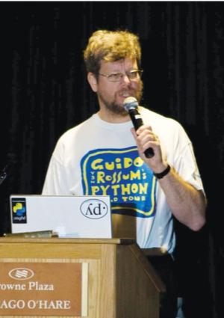
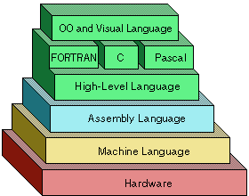
The Python Language
the language we will use in this class
a “high-level programming language”, its instructions are translated into more detailed instructions required by the computer’s central processing unit (CPU)
developed in early 1990s by Guido van Rossum
  Great documentary – The Story of Python… at https://www.youtube.com/watch?v=GfH4QL4VqJ0
Src: http://www.basicknowledge101.com/categories/code.html
Notes:
** PASS BINDER AROUND **

Slide 9
Why Use Python?
  Allows programmers to easily create and quickly modify programs
  Much simpler and cleaner syntax than other popular languages (such as C++ and Java) → “easy” to learn
  Very widely used – industry (e.g. Google, Amazon, …), academia, government (e.g. NASA)
  Vast number of “libraries” (also called “’packages”) have been written for it, extending its capabilities (e.g. web scraping, machine learning, graphics, music, etc.)
  Very popular and effective language for analytics/data science/O.R. for reasons above

Slide 10

Programming Environments
several ways of creating a computer program
  text editor - program for entering and modifying text such as a Python program.
  Integrated Development Environment (IDE) Normally consists of:
    source code editor
    console for running and testing code
    automation tools
    debugger
For this class, we’ll be
using the Spyder IDE
Notes:
Do quick example – guess my # - probably write it from scratch - in text editor and console, then in spyder
Text Editors
Lots! (Sublime,
Integrated Development Environment (IDE)
Why use IDE?
https://www.quora.com/Why-should-I-use-an-IDE

Slide 11
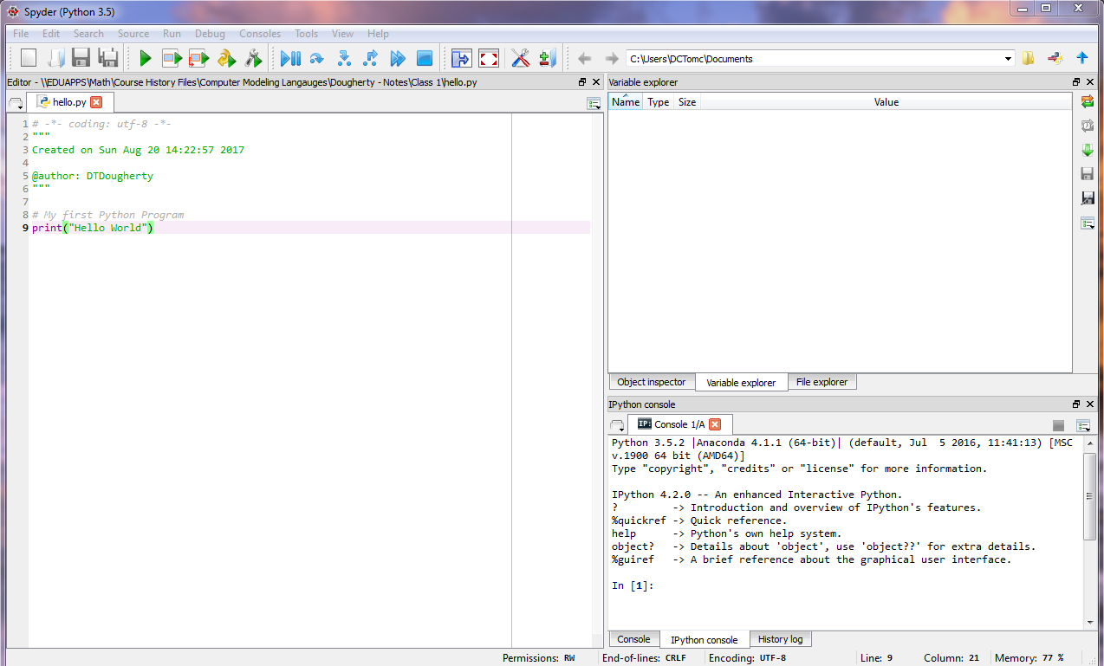
Spyder IDE
← Editor
Console →

Slide 12
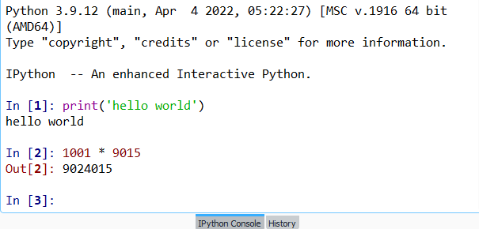
Python modes: interactive and editor
Interactive mode
  allows you to write python statements directly in the console window
  you can run instructions one at a time
  allows quick ‘test programs’ to be written
Console ->

Slide 13
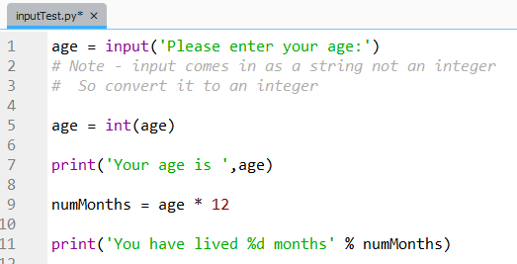
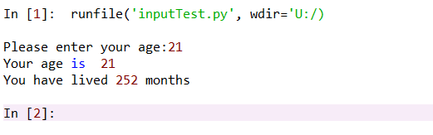
Python modes: interactive and editor
Editor mode
  you write/save a complete Python program in a file
  the interpreter executes the instructions all at once
`
These modes are common to many other languages as well, not just Python.
← Editor
Console →

Slide 14
Some practice in ‘interactive mode’ in the console
Open Spyder
Type these at the console prompt (the “>>>” symbol or In [1]:):
>>> print(‘Hello World’)
>>> 5+3
>>> 5*3
Try multiplying 2 huge #s
>>> print(‘cat’ + ‘dog’)
>>> print('cats', 3, 'dogs‘ ,2)
>>> print(‘cat’ * 20)
>>> input()
>>> input(‘Pick a number:’)
Try other variations on these.

Slide 15
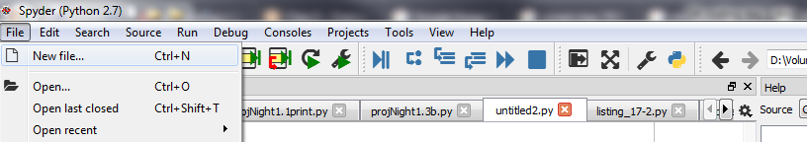
Let’s build your first program!
Under the “File” menu, choose “New file…”:
Type the following as exactly as shown into the editor (at the bottom of the file):
  print(‘Hello World’)
Under the “File” menu, choose “Save” and name the file hello.py

Slide 16
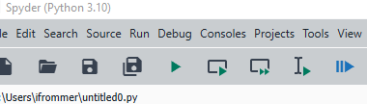
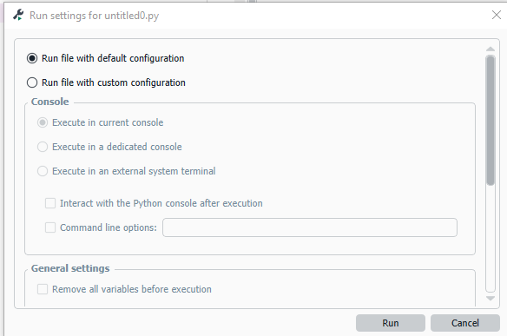
First program continued…
Run the program: under the “Run”
menu, choose “Run” or click the Play button
(you may see window at right the first time, just
click “Run”)
Observe the output in the console.
Edit the program by adding this “comment” one line above the print(“Hello World”) world line:
# My first Python program.
Save and run the program again, observing the output (see steps 3-5), which is unaffected by the comment.

Slide 17
Analyzing your First Program
Comment: provides descriptive information
  # My first Python program.
  print(“Hello World”)
Argument: value(s) that a function needs to carry out a task
Statement: expresses some action to be carried out
Function: a collection of programming instructions that carry out a particular task
Notes:
“Use your words!”

Slide 18
Arithmetic

Slide 19
Basic Arithmetic Operations
Python supports all of the basic arithmetic operations:
  Addition +
  Subtraction -
  Multiplication *
  Division /
  Powers **
Precedence remains the same as what you are used to:
      Parenthesis, Exponent, Multiply/Divide, Add/Subtract
is written as: (3*a-b) / c**2
Notes:
*Operators!!!

Slide 20
Floor division
Floor division computes the quotient and discards the fractional part.
For example,
while 9 / 4 = 2.25
to perform floor division in Python, use the // operator:
9 // 4 = 2
the fractional part (0.25) has been discarded.
Notes:
On board/paper do 9 divided by 4 elementary school style – 2 R 1

Slide 21
Modulus
The modulus operation finds the remainder after dividing two integers.
For example,
The remainder of 9 / 4 is 1
To perform modulus in Python, use the % operator.
For example,
9 % 4 gives the output 1

Slide 22
Variables

Slide 23
Variables
A variable is a storage location in a computer program.
We define variables using an assignment statement, which places the value into a variable:
x = 4
variable naming rules:
  must start with letter or _
  after than can contain letters, numbers or _
  cannot be a reserved Python keyword (like if, def, in, etc.)
  examples: x, _bin, score_21
variable naming conventions in Python:
  lower case, separate words with _ as in my_variable
  this is known as snake_case
Notes:
Variable Types: numbers (int, floats), strings, dictionaries, lists

Slide 24
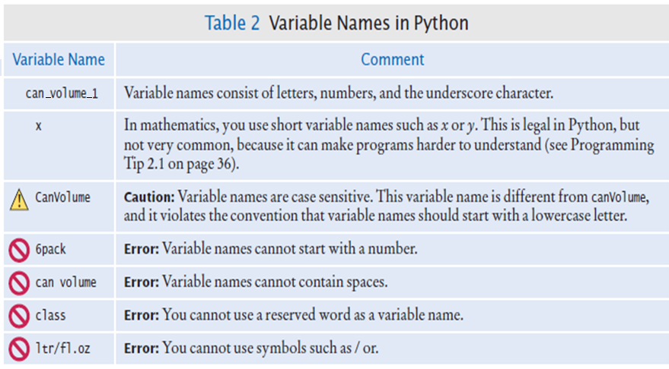
Naming Conventions for Variables

Slide 25
Variables
Now that the integer 4 is stored in the variable x, we can use it how we’d like:
x = 4
print(x)
print(x + 1)
Etc….
Notes:
Variable Types: numbers (int, floats), strings, dictionaries, lists

Slide 26
Variables
Variables can hold lots of things:
  Integers: 4
  Floats: 4.2
  Strings “hello world!”
  Lists [8, “eight”, 8.0]
  Etc…
Notes:
Variable Types: numbers (int, floats), strings, dictionaries, lists

Slide 27
Data Types
The data type of a value determines how the data is represented in the computer and what operations can be performed on that data
Data type is associated with the value, not the variable.
Examples of data types are integer, floating point number, Boolean, string, etc.

Slide 28
Numeric Data Types
An integer (int) value is a whole number, without a fractional part.
A floating-point (float) number includes the fractional part of a number (which could be 0).
Label the following numbers as an int or a float.
(a) a = 6
(b) b = -6
(c) c = 6.2
(d) d = 6.0
*CODING TIP* The type() function is useful to determine the data type assigned to a variable. Try type(d) … what’s the output?

Slide 29
Example: Mixing an int with a float
Consider the following code. What will the output be?
a = 2
a = a + 1.0 # replaces value of a with a + 1.0
print(a, type(a))

Slide 30
Strings

Slide 31
Strings
A string is a sequence of characters within a pair of either single or double quotes.
A string is another data type.
A string can be stored in a variable. For example,
var = “Hello” or var = ‘Hello’
Why does Python allow both types of quotes?
What’s the difference between n = 17 and n=“17”?
Notes:
If a string itself contains a single quote, defining it with double quotes eliminates the need to escape the internal single quote with a backslash. For example, 'It\'s a beautiful day.' can be written as "It's a beautiful day.", improving readability. The same applies in reverse: if a string contains double quotes, using single quotes to define the string avoids escaping.

Slide 32
String Length: len()
The number of characters in a string is called the length of the string and can be found using Python’s len() function.
Consider the following code. What do you expect the output to be?
greeting = “Hello”
print(len(greeting))
TRY: empty_string = “”
print(len(empty_string))
What is the output? Does it make sense?

Slide 33
String Concatenation: +
We can concatenate strings (put them together to yield a longer string) using the + operator.
Consider the following code; what is the output?
first_name = “John”
last_name = “Smith”
name = first_name + last_name
print(name)
How would you adjust the code so that there is a space between the first and last name?

Slide 34
String repetition: *
We can also produce a string that is the result of repeating a string multiple times using the * operator.
Consider the following code; what is the output?
message = “Echo…”
print(message * 5)

Slide 35
Accessing characters in a string: []
You can access individual characters of a string based on their index (position) within the string, using the [] operator.
Note: The starting index is 0.
For example,
greeting = “Hello”
print(greeting[0])
prints “H”
Notes:
Index Very important

Slide 36

Accessing characters in a string: []
Let name be a variable that holds the user’s name. Write code that prints the last letter in name.
name = “Jamie”
print(name[len(name)-1])
Here’s another way:
print(name[-1])
What do you think this will output:
print(name[-2])
Notes:
Index

Slide 37
Converting Numbers to Strings
Use the str() function to convert between numbers and strings
  Ex: str(4) gives “4”

Slide 38
Converting Strings to Numbers
To turn a string containing a number into a numerical value, use the int() and float() functions
  Ex: int(“4”) gives 4
    float(“4”) gives 4.0

Slide 39
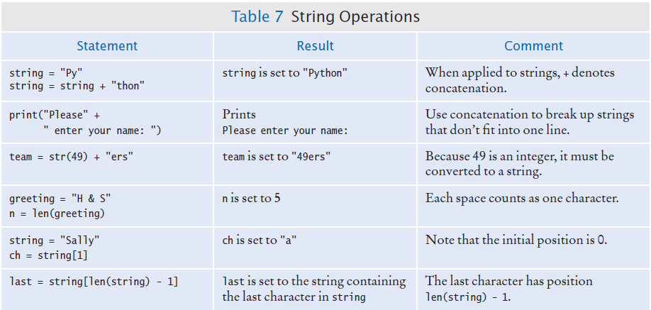

String Operations
Notes:
What do you think it will do?

Slide 40
String Operations
Notes:
What do you think it will do?

Slide 41
Methods
An object represents a value with certain behavior.
A method is a collection of programming instructions that carry out a particular task and can only be applied to an object of the type for which its defined.
`
For now, we will only talk about string objects.
Notes:
Unlike a function, which is a standalone operation, a method can only be applied to an object of the type for which it was defined.
Methods are specific to a type of object
Functions are general and can accept arguments of different types
A method is a function owned by a class. Like a function bc it is a collection of programming instructions that carry out a particular task. Unlike a function, which is a standalone operation, a method can only be applied to an object of the type for which it was define.
s = “John Smith”
s.upper()
JOHN SMITH
s.lower()
john smith
s.replace(“John”, “Mary”)
→ Mary Smith

Slide 42
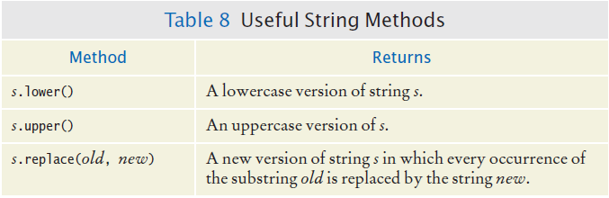
Some Useful String Methods
Note - .replace returns a new version of the string with the replacement made; it does not overwrite the existing string variable (see console)

Slide 43
String Escape Sequences
To print a double quote in a string:
print("He said \"Hello\"") or
print(‘He said "Hello"’) or
To print a backslash, precede the \ with another \:
print(“The operator for division is \\”)
To print a newline, use \n:
print("*\n**\n***\n")
*
**
***

Slide 44
Input and Output
You can read a String from the console with the input() function. For example,
name = input("Please enter your name”)
Enter the following code, what happens?
age = input("Please enter your age”)
print(“Your age in dog years is”, age/7)
NOTE: input will be stored as a string
…How can we fix the above code?

Slide 45
Python comments
Commenting your code is a way to explain your code. This is good practice to remind yourself what the code is doing, and for others to easily understand your code.
To comment your code:
use # symbol

Slide 46
Commenting Code example:
##
# This program computes the volume (in liters) of a six-pack of soda
# cans and the total volume of a six-pack and a two-liter bottle
#
# Liters in a 12-ounce can
CAN_VOLUME = 0.355
# Liters in a two-liter bottle.
BOTTLE_VOLUME = 2
# Number of cans per pack.
cansPerPack = 6
# Calculate total volume in the cans.
totalVolume = cansPerPack * CAN_VOLUME
print("A six-pack of 12-ounce cans contains", totalVolume, "liters.")
# Calculate total volume in the cans and a 2-liter bottle.
totalVolume = totalVolume + BOTTLE_VOLUME
print("A six-pack and a two-liter bottle contain", totalVolume, "liters.")

Slide 47
‘if’ Statement

Slide 48

A decision situation and the if statement
Amusement park
  Pricing depends on age –
    12 and under: child pricing
    Over 12: adult pricing
Approach in English (we sometimes call this “pseudo-code”):
  if the person’s age is 12 or under charge child pricing
  otherwise charge adult pricing

Slide 49
Decisions and the if statement
the if statement is a way a computer program can make decisions based on input, or circumstances
If statements are of the following form
if condition:
statements₁
else:
statements₂
Note: you may omit the else branch if there is nothing else to do.
Notes:
The if statement allows a program to carry out different actions depending on the nature of the data to be processed.

Slide 50
A decision situation and the if statement
Recall the pseudo-code from our Amusement park ex.:
  if the person’s age is 12 or under charge child pricing
  otherwise charge adult pricing
Let’s convert this to Python code:
if age <= 12:
print('Child pricing')
else:
print('Adult pricing’)
if condition:
statements₁
else:
statements₂

Slide 51
Decisions and the if statement
Note:
  You can include several statements under a condition.
  Follow the level of indent carefully as shown below.
CHILD_PRICE = 15.75
ADULT_PRICE = 23.75
if age <= 12:
guest_price = CHILD_PRICE
print(‘Child pricing’)
else:
guest_price = ADULT_PRICE
print(‘Adult pricing’)
Notes:
The if statement allows a program to carry out different actions depending on the nature of the data to be processed.
*Capitalized variable names indicate constant variables

Slide 52
The if statement is an example of a compound statement
Compound statement -
  common in Python
  consists of header(s) and statement block(s)
  header must end with a colon (:)
  statement block is a group of one or more statements and must have the same indentation level.
if age <= 12:
guest_price = CHILD_PRICE
print(‘Child pricing’)
else:
guest_price = ADULT_PRICE
print(‘Adult pricing’)
header
statement block
Notes:
The if statement allows a program to carry out different actions depending on the nature of the data to be processed.

Slide 53
Relational Operators

Slide 54
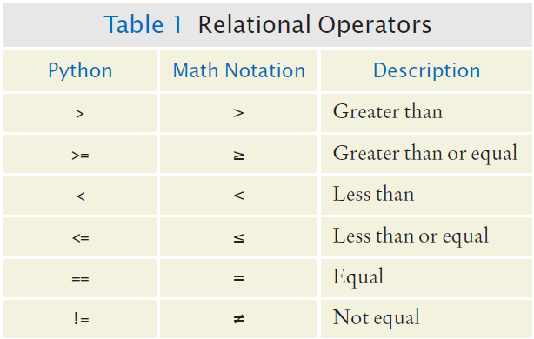
Relational Operators
The condition in an if statement often consists of a relational operator.

Slide 55
Assignment vs. Equality Testing
Assignment: makes something true.
age = 19
Equality testing: checks if something is true.
if age == 19 :
Note: the line of code above is a header. It would be followed by a statement block.

Slide 56
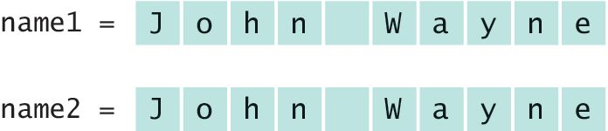
Checking for string equality
For two strings to be equal, they must be of the same length and contain the same sequence of characters:

Slide 57
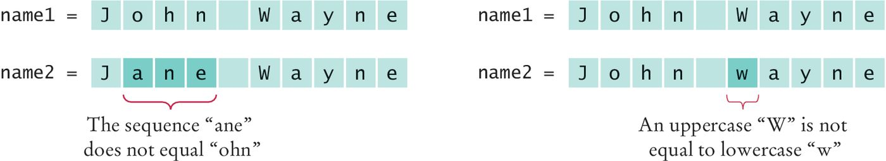
Checking for string equality, cont’d
If any character is different, the two strings will not be equal:

Slide 58
Comparing Strings
Checking if two strings are equal
if name1 == name2 :
print("The strings are identical")
Checking if two strings are not equal
if name1 != name2 :
print("The strings are not identical")

Slide 59
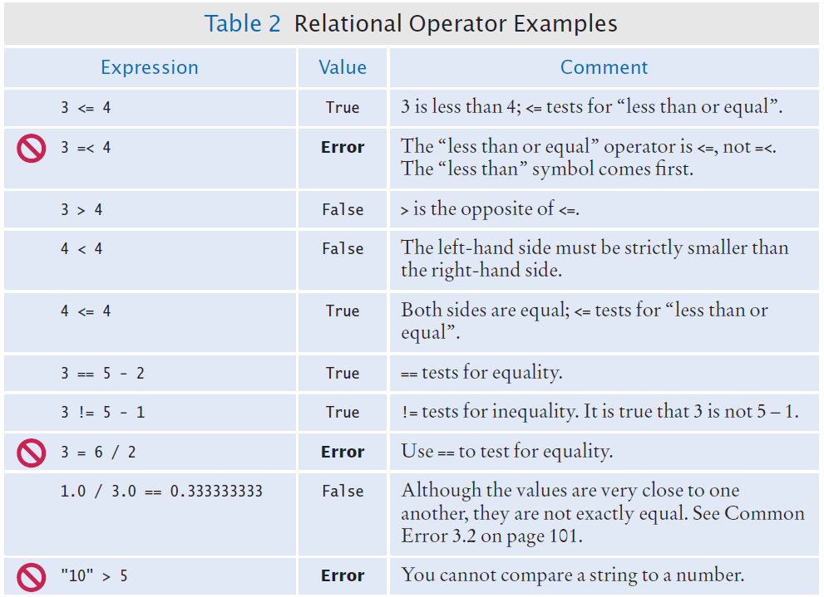
Relational Operators
These book tables are often great for testing your knowledge.

Slide 60
Relational Operators
These book tables are often great for testing your knowledge.

Slide 61
Relational Operators, cont’d

Slide 62
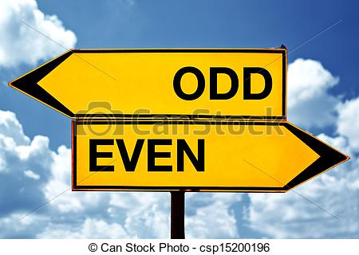

You Try – Programming Exercise
Write a program that asks the user to enter a number
If the user enters an even number, print “EVEN”
If the user enters an odd number, print “ODD”

Slide 63
Functions

Slide 64
Functions
Recall from your previous Mathematics courses:
  a function f is a rule that assigns input(s) x, to an output f(x)
For example:
f(x) = x + 3
If our input, x, is 2…
Then our output, f(2) is 5

Slide 65
Functions
f(x) = x + 3
We can represent this function in Python:
def f(x):
y = x + 3
return y
Try this out in the console (or the editor).
* CODING TIP: note the indentation structure and the significance of the colors of text in Spyder *

Slide 66
Functions
f(2)
We can find f(2) by calling this function:
def f(x):
y = x + 3
return y
print(f(2))
*NOTE* Order matters – more on this later!

Slide 67
Functions
Programming definitions:
  function - a collection of programming instructions that carry out a particular task
  argument - a value that a function needs to carry out that task.
In our example:
def f(x):
y = x + 3
return y
What’s the argument?
What is/are the instructions carried out?

Slide 68
Functions - Syntax
Basic syntax for a function:
def functionName(argument):
statements
return value
Note: functions need not have arguments, nor return values

Slide 69
Functions – You Try
Ex. 1: Write a function to represent the following:
f(a) = a² + 1
Test it out with an input a = 3
Ex 2: Write a function to represent the following:
f(m, n) = m + n
Test it out with inputs m = 8 and n = 3
Challenge problem: Write a function to perform elementary-school division:
    Given: dividend and divisor
    Return: quotient and remainder
*NOTE* When calling a function, you must provide the correct type and number of arguments required by the function
Hint: if x is a variable, this will work: print(‘The answer = ‘, x)
Notes:
def esDivide(dividend, divisor):
q = dividend // divisor
r = dividend % divisor
print(dividend,'divided by',divisor,=',q,R',r)
return (q,r)

Slide 70
Functions
Python has lots of useful, built-in functions that are ready to use!
For example:
abs(-173) returns the value 173
round(2.3) returns the value 2
max(3, 10, 2) returns the value 10
Another function you have used: print()
Notes:
# List all built-ins
import builtins
import types
builtin_function_names = [name for name, obj in vars(builtins).items()
if isinstance(obj, types.BuiltinFunctionType)]
builtin_function_names

Slide 71
Floating-point to integer conversion
You can use the functions int() and float() to convert between integer and floating point values:
  total = 2.53
  tax = 2.53*1.0635
  balance = total + tax # balance: float
  dollars = int(balance) # dollars: integer
You lose the fractional part of the floating-point value (no rounding occurs)

Slide 72
Intro to lists

Slide 73
Lists
A list is a container that stores a sequence of values (an ordered collection of objects).
A list can hold a combination of integers, floats, strings, etc.

Slide 74
Creating a List
Syntax: the square brackets indicate that we are creating a list:
[value₀, value₁, value₂,…,value_{n-1}]
Examples:
list_1 = [] # creates an empty list
# lists initialized with values in them:
list_2 = [32, 54, 44, 95, 11]
list_3 = [‘alpha’,’broadway’,’Chicago’]
list_4 = [1,’one’,232,’up’,[12,13],999]

Slide 75
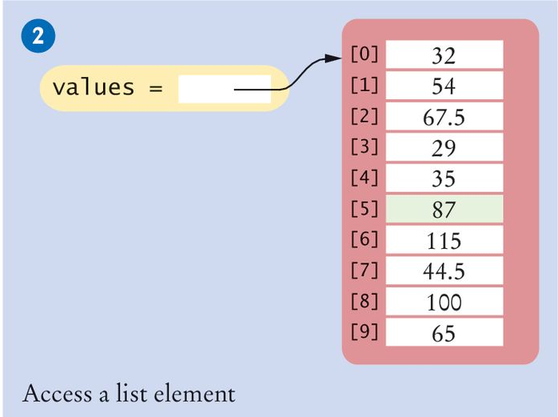
Creating Lists/Accessing Elements
# In Python, we can access an element in a list:
values[5] # this also works for strings
# You can replace items in a list:
values[5] = 87 # note this does not work for strings

Slide 76
Determining List Length
You can use the len() function to obtain the length of the list; that is, the number of elements:
Where have we seen this before?
  num_elements = len(values)

Slide 77
Strings as Lists
Recall, strings are sequences of characters.
We can also think of a string as a list of characters
Consider:
  firstName = "Adeline“
  We can think of the string “Adeline” is a list of characters A,d,e,l,i,n,e with length 7. To access the 6th item in the list (which has an index 5):
  print(firstName[5])
  produces the output n

Slide 78
range function
The range function generates a sequence of integers.
You can treat this sequence like a list; so if you find yourself needing a list such as
[0, 1, 2, 3, 4]
use the range function. To generate this particular sequence as above, type range(5)
In general, the range function is:
range(start, stop, step)
Note: if you omit the start and step arguments, it defaults to 0 and 1, respectively.

Slide 79
‘for’ Loop

Slide 80
The for Loop
A for loop is useful to iterate over the contents of any container.
  A container is an object that contains or stores a collection of elements, like a string or a list.
Use a for loop when you need to access elements in a container one at a time.
Syntax:
for variable in container :
statements

Slide 81
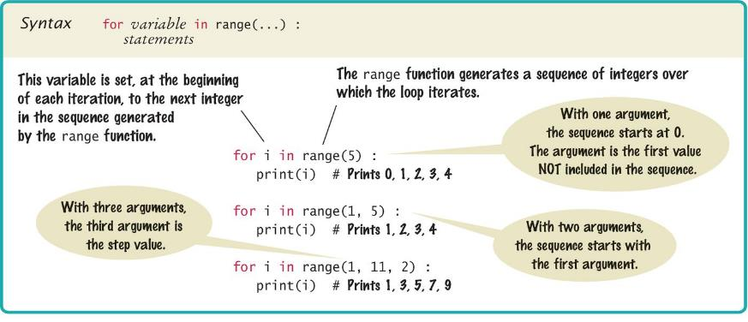
Syntax of a for Statement (Range)
A count-controlled for loop iterates over a range of integer values
We can do this using the range function

Slide 82
Extra Slides

Slide 83
Python libraries (modules)
library - collection of code, written and compiled by someone else (or you), that is ready for you to use in your program
standard library - a library that is considered part of the language and must be included with any Python system
Python’s standard library is organized into modules.
  Related functions and data types are grouped into the same module.
  Functions defined in a module must be explicitly loaded into your program before they can be used.

Slide 84
Example: sqrt() from Math Module
The math module contains the function sqrt(). To use it, we need to import the math module.
    # First include import statement at the top of
    # your program file.
    from math import sqrt
    x = 64
    # Then you can simply call the function.
    y = sqrt(x)
    print(y)
  Alternatively, you can use import math which would require you to type the library name plus a period before using its functions:
  import math
  y = math.sqrt(x)
Notes:
Vacuum cleaner analogy
We can vacuum the floor out of the box
To vacuum the curtains, we attach the rod, which is in the box (importing from the standard library)
To use the special pet hair attachment, we first buy that then attach (installing library for free btw then import)

Slide 85
Importing modules
To import multiple functions from the same module:
from math import sqrt, sin, cos
To import the entire contents of a module:
  from math import *

Slide 86
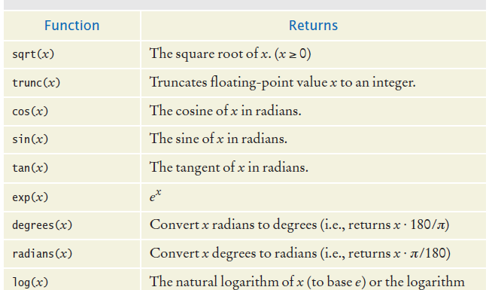
Functions from the Math Module
Notes:
This is from the textbook.
Type dir(math) in the console after importing it.

Slide 87
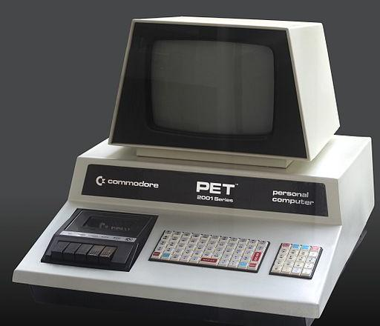
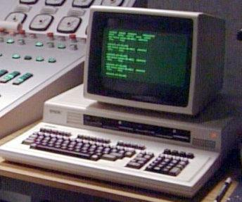
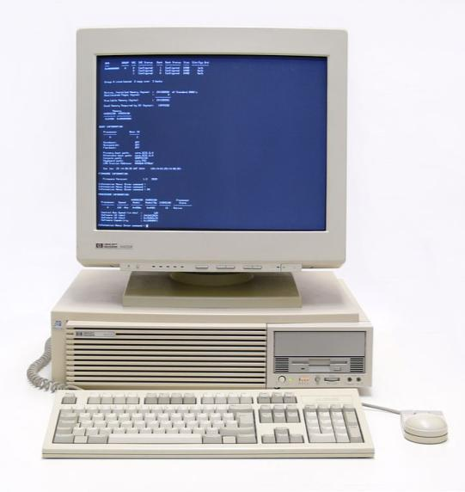

Some hardware I have used:
Commodore PET (1977)
←
Epson
QX-10 (1983) →
HP 9000
(mid-late ← 1980s)
Power Mac 7600
(1996) →
PET Photograph by Rama, Wikimedia Commons, Cc-by-sa-2.0-fr; HP By Thomas Schanz - Own work, CC BY-SA 3.0, https://commons.wikimedia.org/w/index.php?curid=31052634

